Slide 1
Group ProjEct - 3
Ruthwik Reddy * Tanvi
Vibhuti * Nithik Roshan

Slide 2

Tesla Stock Data
We have took Tesla, SP500 Stock data from Jan 22nd to April 4th.
Calculated Daily Return Using :

Slide 3
Risk Free Rate:
Considering 3 month Treasury Yield as Risk free rate
Annual Rate : 5.25%
Daily Rate : 5.25/252 = 0.02%

Slide 4
Categorizing Data
We are categorizing data based on RF.
i) TSLA return < RF
ii) TSLA return >=RF

Slide 5
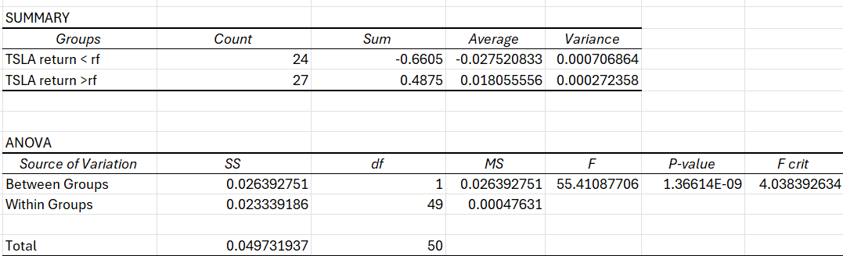
ANOVA
F-value> F Crit, indicating variance between groups is greater than within Groups.

Slide 6
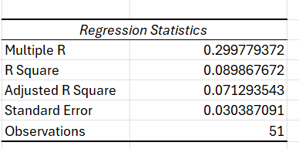
CAPM regression Model
Goodness of Fit :
Multiple R is very low, indicating not a good fit for this data.

Slide 7
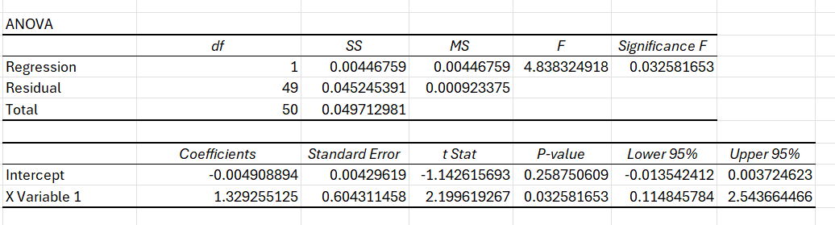
ANova and factor table

